Slide 1
Web Programming
Lecture 3

Slide 2
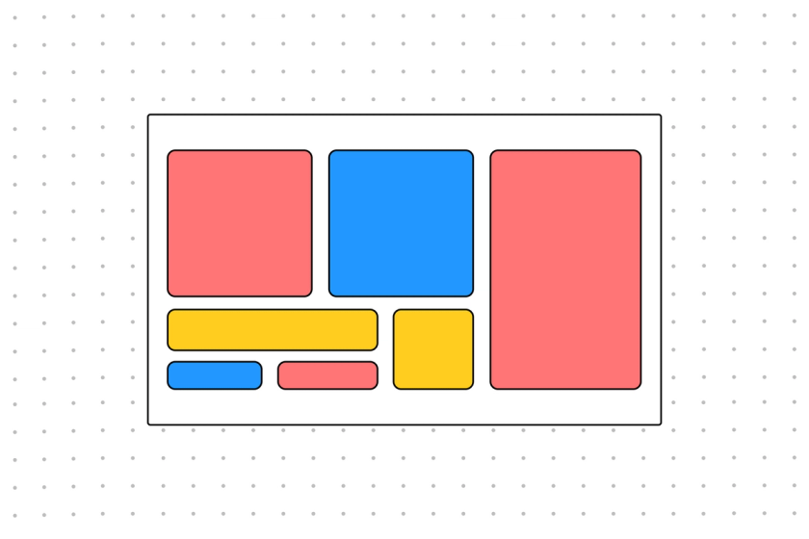
Grid Layout

Slide 3
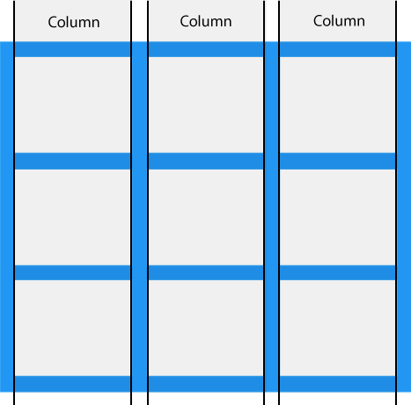
Grid Columns

Slide 4
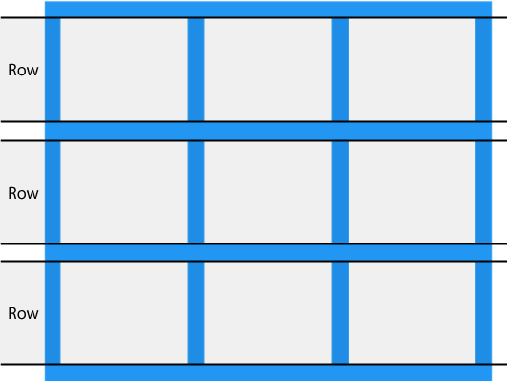
Grid Rows

Slide 5
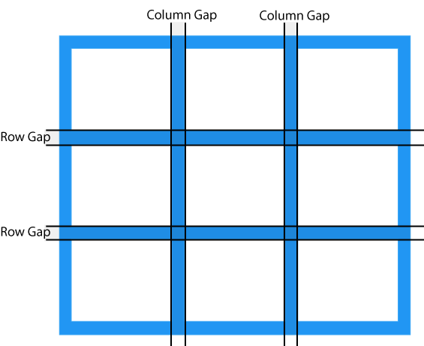
Grid Gaps

Slide 6
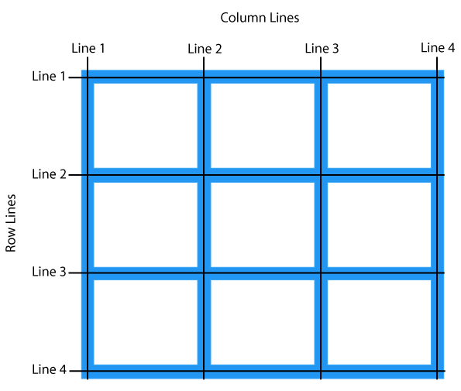
Grid Lines

